Slide 1


Slide 2
MISSION STATEMENT
Providing affordable advertisement medium with interactive platform
enabling Malaysian companies especially the SME’S to go global at a faster pace

Slide 3

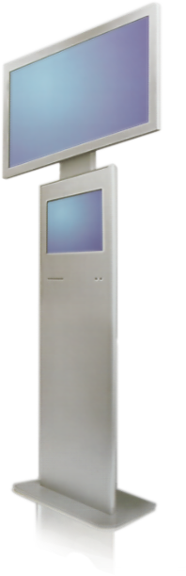
HYBRID KIOSK
“Two in One”
Compelling Ads
+
Interactive
“rich content”
digital trade directory

Slide 4
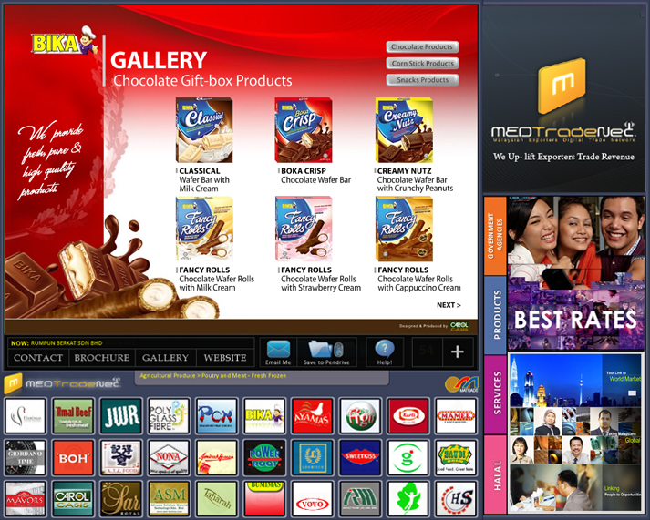
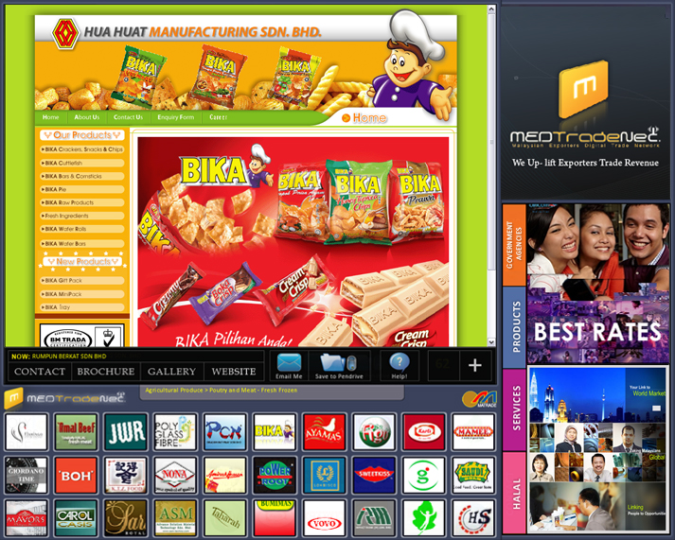
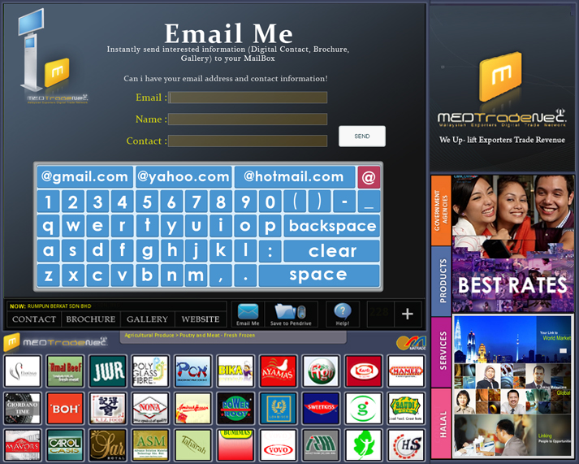
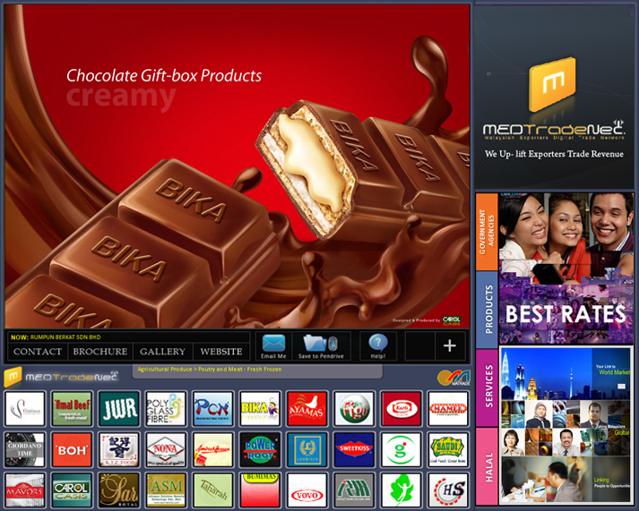
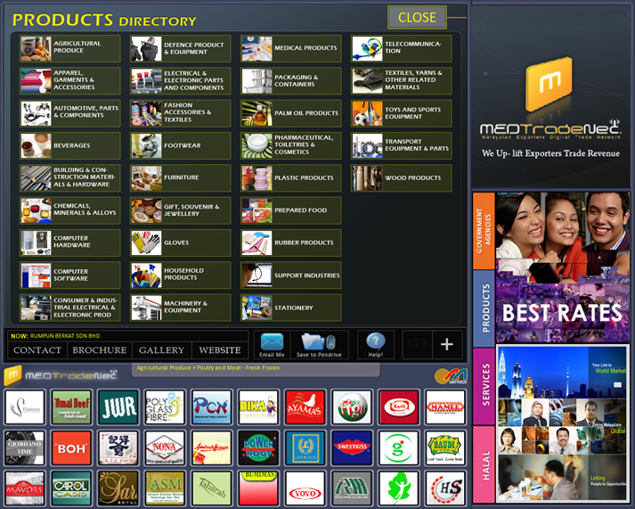
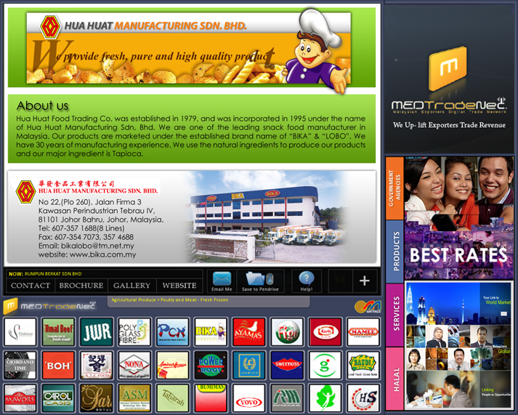
E-mail / Download
E-Contact, Brochure & Gallery
Unlimited ads display cycles
on 19” Touch Screen Monitor
CONTACT
BROCHURE / GALLERY
WEBSITE
Digital Trade Directory

Slide 5
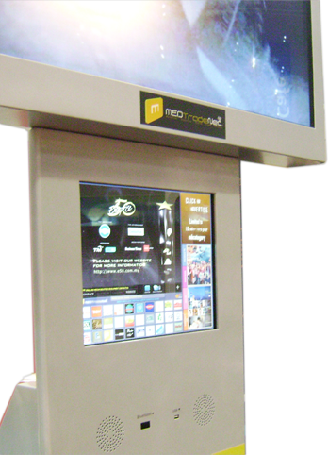
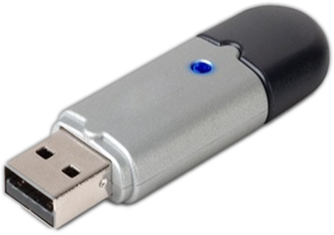
Data Downloading

Slide 6
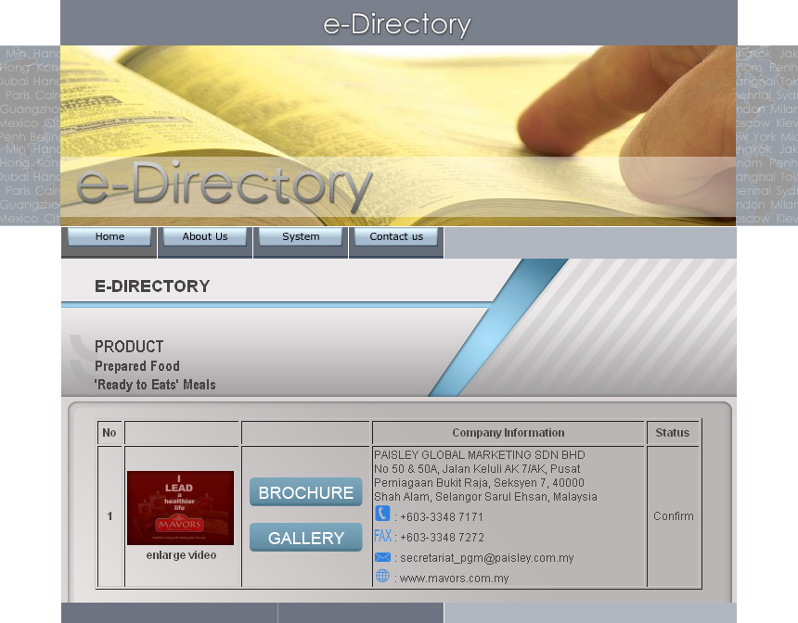
Free e-directory at www.medtradenet.com.my

Slide 7
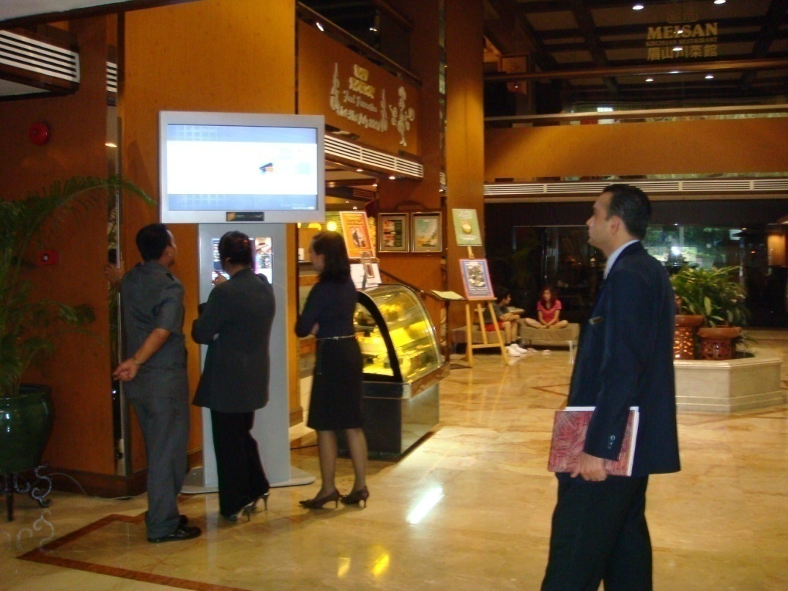
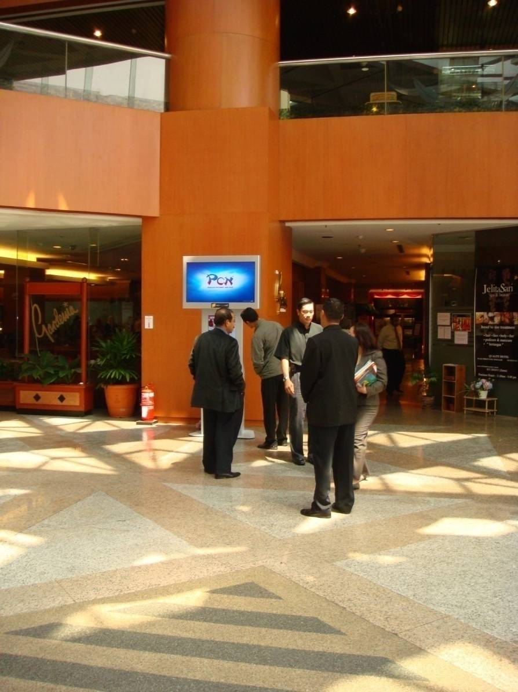
Quality Hotel KL
Quality Hotel Shah Alam

Slide 8
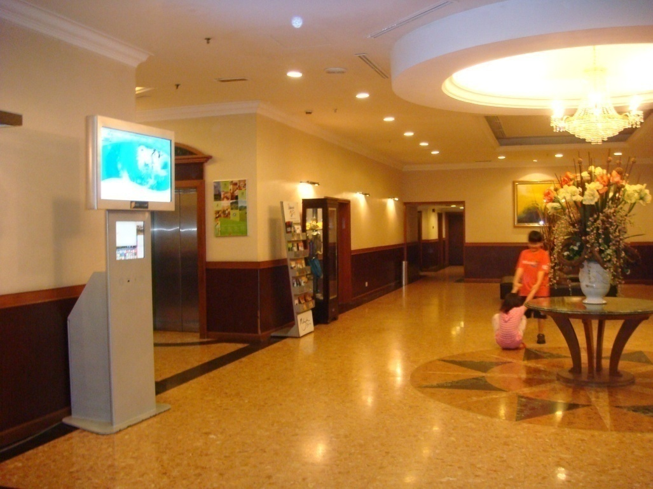
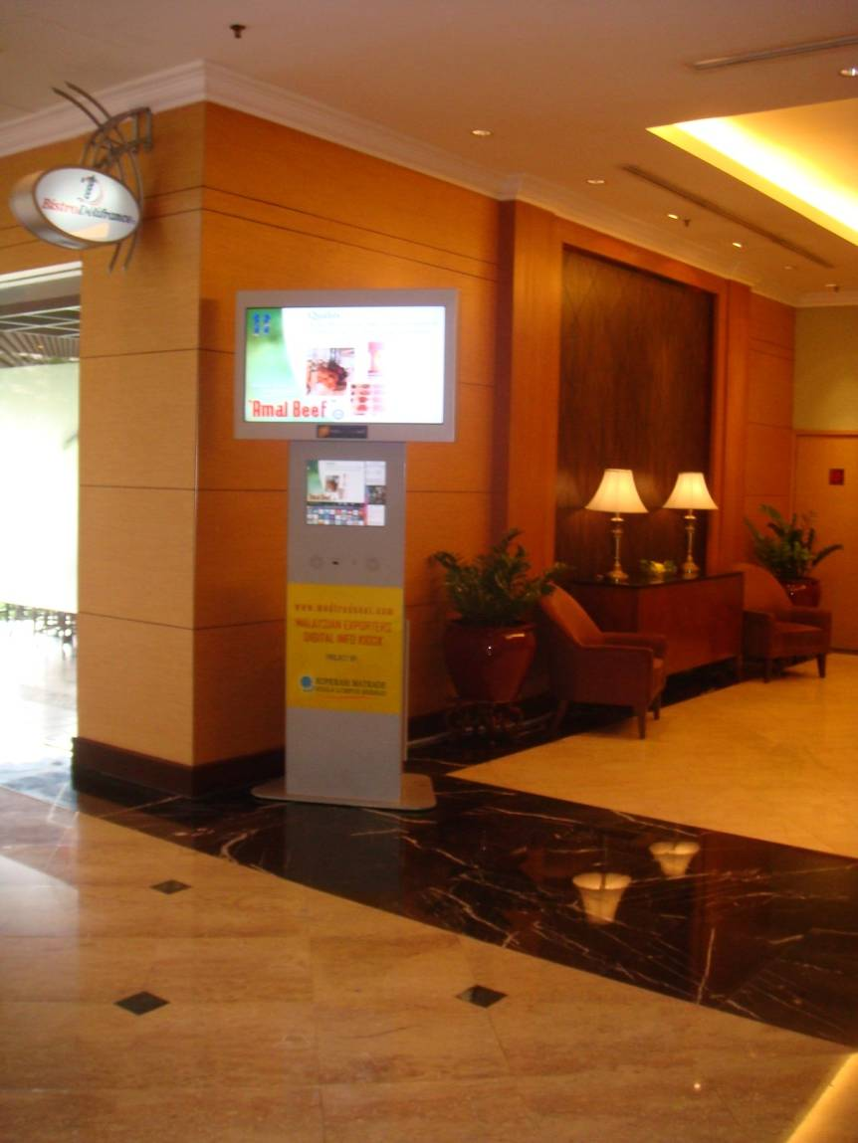
Brisdale Hotel
Flamingo By The Lake, KL

Slide 9
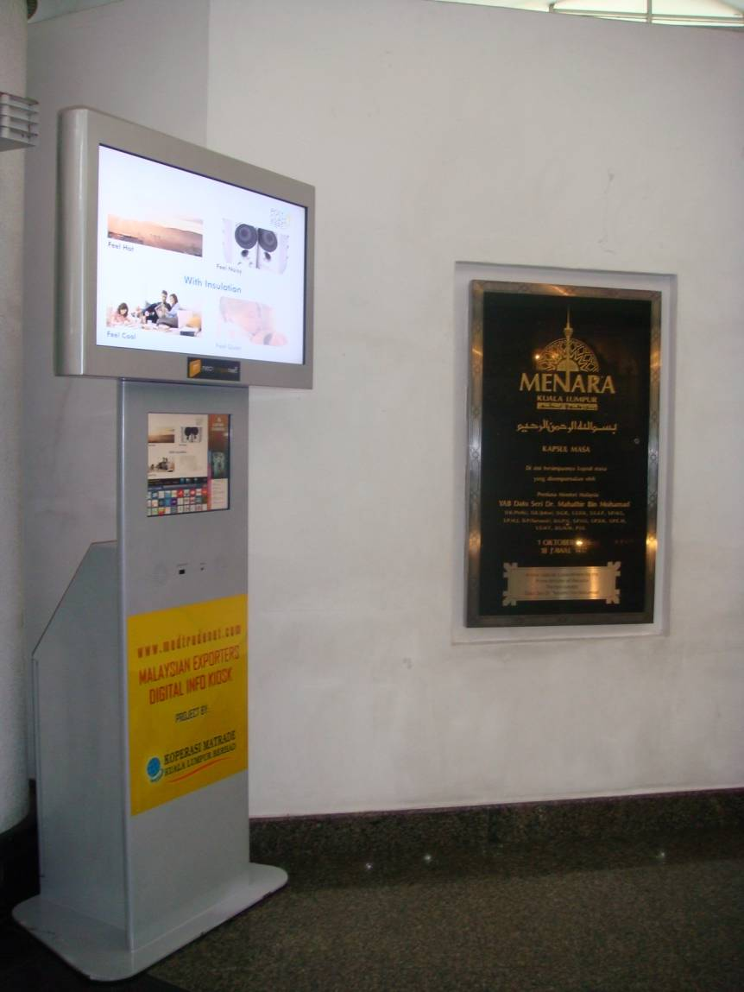
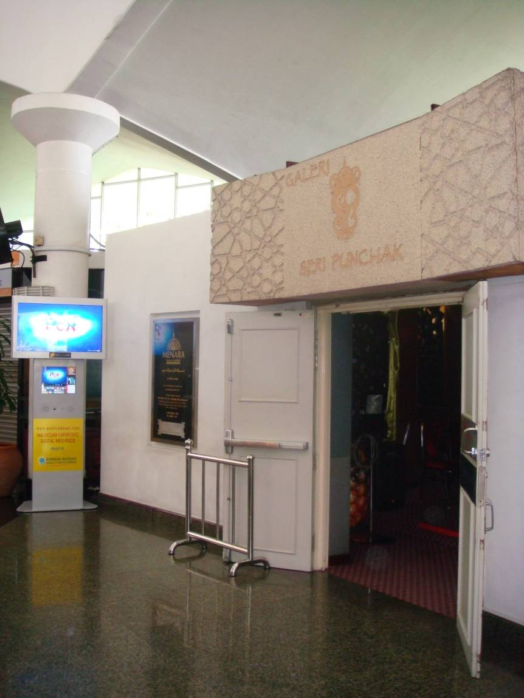
KL Tower

Slide 10
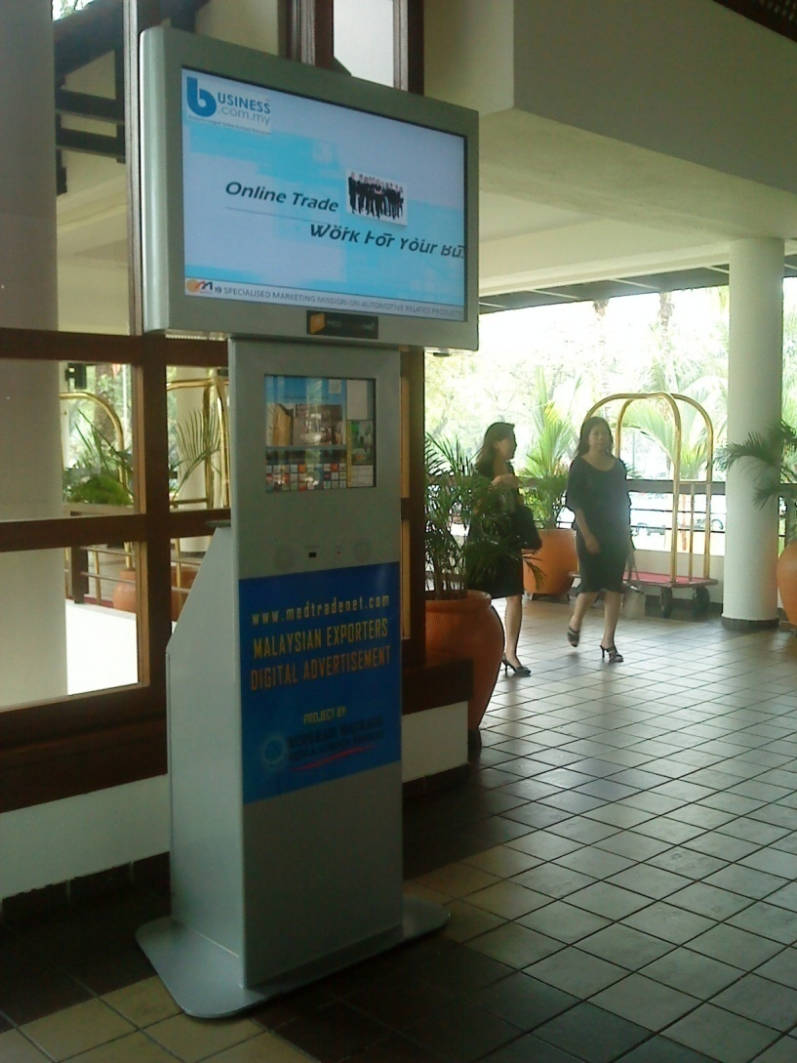
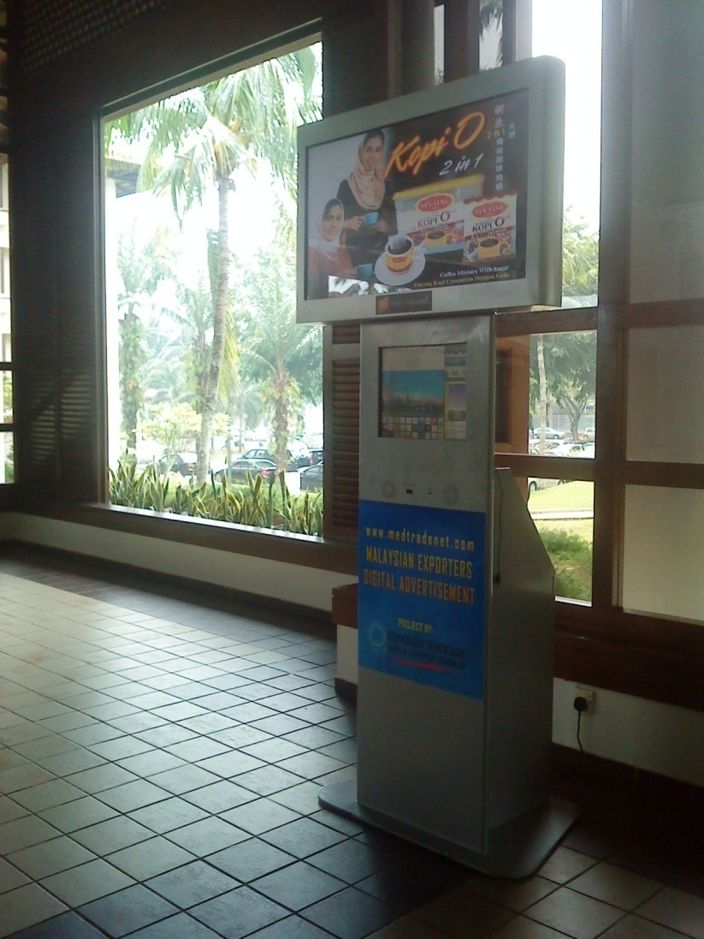
Saujana Hotel

Slide 11
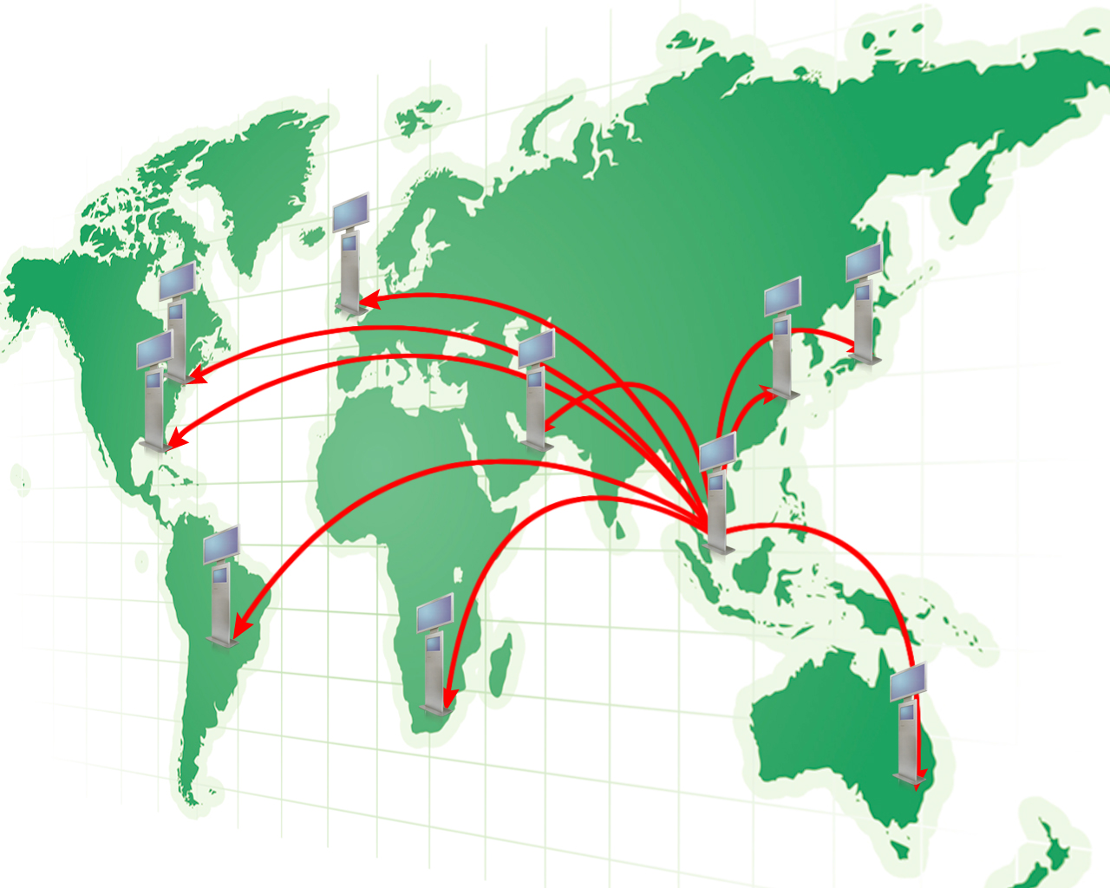
We are not only at MALAYSIA
London
New York
Tokyo
Shanghai
Miami
Dubai
Sao Paulo
Johannesburg
high ads cost shall no longer be an obstacles to SME’s
to explore business opportunity in the global arena
Sydney
Notes:
11

Slide 12
Government Buildings and Airport
KLIA (Arrival Hall) – MATRADE Business Information Center
Tourism Development Corporation @ Menara Dato Onn
Tourism Development Corporation @ Saloma Restaurant
MDEC
Putrajaya International Convention Center
SSM
Immigration Putrajaya

Slide 13
Hotels
Concorde Hotel Shah Alam
MINES Wellness Hotel
Novotel KLCity Centre
The Legend Hotel KL
Sri Pacific Hotel
New World Hotel
Renaissance Hotel
Palace of the Golden Horses
Park Royal Hotel
Federal Hotel Kuala Lumpur
Pan Pacific KLIA
Hotel Capitol
Maple Suite
Hotel Midah KL
Mandarin Court Hotel
Prescott Inn Medan Tuanku KL
Puteri Park Hotel
Lanson Place Ambassador Row
Sheraton Subang
Pullman
Holiday Villa Subang
Citrus Hotel KL
Corus Hotel KL
Grand Pacific Hotel
Concorde Inn KLIA
Corona Inn KL
Crown Princess KL
Crowne Plaza Mutiara KL
Duta Vista Executive Suites
Dynasty Hotel
Eastin Hotel
Empress Hotel Sepang
Grand Seasons Hotel
Holiday Inn Glenmarie
Hotel Equatorial Bangi
Hotel Grand Continental KL
Hotel Malaya
Hotel Nova
Impiana KLCC Hotel and Spa
Klang Histana Hotel
Melia KL
Pacific Regency Hotel Suites
Alpha Genesis Hotel
Pearl International Hotel
Picolo Hotel KL
The Coronade Hotel
The Plaza Hotel
The Royale Bintang Hotel
Vistana Hotel KL
PNB Darby Park
Radius International Hotel
Swiss Garden Hotel KL
Swiss Inn
Ancasa Hotel & Spa KL
Armada Hotel PJ
Concorde Hotel KL

Slide 14
Shopping Complex
Bangsar Village
Low Yat Plaza
Central Market
Maju Junction
Sogo
Ampang Park
Ampang Point
Cheras Leisure Mall
Summit USJ
Pertama Complex
The Curve
Cineleisure
Tropicana Mall
Bukit Bintang

Slide 15
Golf Resorts
Saujana Golf and Country Club
Tasik Puteri Golf and Country Club
Templer Park Country Club
Palm Garden Hotel IOI Resort
Mines Golf & Country Resort
Kelab Golf Sultan Abdul Aziz Shah
Glenmarrie Golf & Country Club
Kuala Lumpur Golf & Country Club
Royal Selangor Golf Club
Monterez Golf & Country Club

Slide 16
EXHIBITION LIST
No. | Exhibition | Venue | Date
1 | GERAK USAHAWAN 2009 | PWTC | 6-8 Feb 09
2 | MIHAS 2009 | MECC | 6-10 May 09
3 | SMIDEX 2009 | KLCC | 3-5 June 09
4 | FIM 2009 | PWTC | 31Jul to 2 Aug 09
5 | IPMEX 2009 | PWTC | 6-9 Aug 09
6 | ASIA LABEL 2009 | PWTC | 6-9 Aug 09
7 | COMMERCIAL PRINT PACKAGING & MULTIMEDIA EXHIBITION 2009 | PWTC | 6-9 Aug 09
8 | LAB ASIA 2009 | PWTC | 11-13 Aug 09
9 | FOOD & HOTEL MALAYSIA 2009 | KLCC | 11-14 Aug 09
10 | PROPAK MALAYSIA 2009 | KLCC | 11-14 Aug 09

Slide 17
EXHIBITION LIST
No | Exhibition | Target Audience | Expected No. of Visitors | Venue | Date
1 | Parenthood Expo 09 | General Public, Parents | 45000+ | MVEC | 21-23 Aug 09
2 | World Argri 09 | Related Industry Biz owners, Managers (90+% local visitors) | 20000+ | PWTC | 5-7 Oct 09
3 | World Military Medicine Expo 09 | Related Industry Biz owners, Managers (90+% local visitors) | 8000+ | KLCC | 5-7 Oct 09
3 | International Baby Show | General Public, Parents | 20000+ | MECC | 6-9 Oct 09
3 | Second (2nd ) National Halal Forum 09 | Related Industry Managers, General Public (90% local visitors) | 8000+ | MECC | 7-8 Oct 09
6 | Beauty Expo 09 | Related Industry Biz owners, Managers, General Public (90+% local visitors) | 18000+ | PWTC | 12-15 Oct 09
7 | Gomobile 09 | Related Industry Managers, General Public (90% local visitors) | 45000+ | KLCC | 20-23 Oct 09

Slide 18
EXHIBITION LIST
No | Exhibition | Target Audience | Expected No. of Visitors | Venue | Date
8 | Ad Asia 09 | Related Industry Biz owners, Managers (90% local visitors) | 8000+ | KLCC | 22-24 Oct 09
9 | Livestock Asia 2009 | Related Industry Biz owners, Managers (90% local visitors) | 15000+ | KLCC | 27-29 Oct 09
10 | M-Plas 09 | Related Industry Biz owners, Managers (90+% local visitors) | 8000+ | KLCC | 4-7 Nov 09
11 | INTRADE 09 | Government Officials, Biz owners, Managers, General Public (90+% local visitors) | 9000+ | MECC | 10-12 Nov 09
12 | Bio Malaysia 2009 | Related Industry Biz owners, Managers (90+% local visitors) | 8000+ | KLCC | 17-19 Nov 09
13 | World Furniture 09 | Related Industry Managers, General Public (90% local visitors) | 20000+ | MECC | 1-2 Dec 09

Slide 19

 | EXCLUSIVE PACKAGE | PREMIER PACKAGE
Display Cycle on 42” LCD Monitor | 30s cycle randomly @ ALL kiosks (min 5102 cycles per year) | 30s cycle @ 12 CUSTOMER SELECT kiosks (min 12 max 57 cycle PER DAY)
FREE AD Design | YES | YES
Sub Category Display | YES | YES
Display in Exhibitions | YES | YES
Website Link | YES | YES
Email Function | YES | YES
Download | YES | YES
Sponsor Panel | - | 1 Minute
CMS | - | YES
Log Retention | - | YES
Yearly Investment | RM 4,990 ONLY*!! | RM 59,880 ONLY*!!
*All prices are subjected to 5% Government Tax

Slide 20
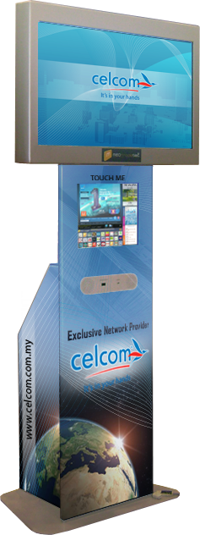
Wrap-Around Package
1 kiosk @ RM 1,000/month
Min sign up for 6 months @ 1 kiosk
Sticker design and material (PVC white base sticker with 1200 dpi printing quality)
Sticker design and material change on monthly basis upon request

Slide 21
Optional Package
Business.Com.MyTM Membership @ RM 688/year
(normal price RM 1,688)
Free corporate web presence
Products display & trade leads
Global business opportunities
Business matching & networking
http://www.business.com.my

Slide 22

WHY MEDTradeNet?
50 Kiosks strategically located within Klang Valley
Exposure to 48 “INTERNATIONAL TRADE FAIRS”
The only digital trade ads and trade directory
MOST Affordable Package – Starting from RM 4,990
SMIDEC Pre approved Marketing Development Grant - SME’s pay only RM 2,495
A project supported by government agencies under the MINISTRY OF INTERNATIONAL TRADE AND INDUSTRY

